Slide 1
Apollo HD Map Construction

Slide 2
ApolloScape Datasets
Some other datasets-
Laser Point Cloud Obstacle Detection and Classification
Traffic Light Detection
Road Hackers
Image-Based Obstacle Detection and Classification
Obstacle Trajectory Prediction
Scene Analysis
Apollo-SouthBay
Scene Parsing
3D Car Instance
Lane Segmentation
Self Localization
Trajectory
3D Lidar Object Detection and Tracking
Stereo
The aim is understand all the datasets and find appropriate AI architectures to solve the problem posed by each dataset

Slide 3
Scene Parsing Dataset
For various autonomous car applications like 2D/3D scene understanding, localization, transfer learning and driver simulation.
Class Labels - 25 labels, 28 more for lane markings.
Contains pixel level and instance level segmented scene images, pixel level segmented lane marking pictures and stored depth maps to provide complete information about a scene.

Slide 4
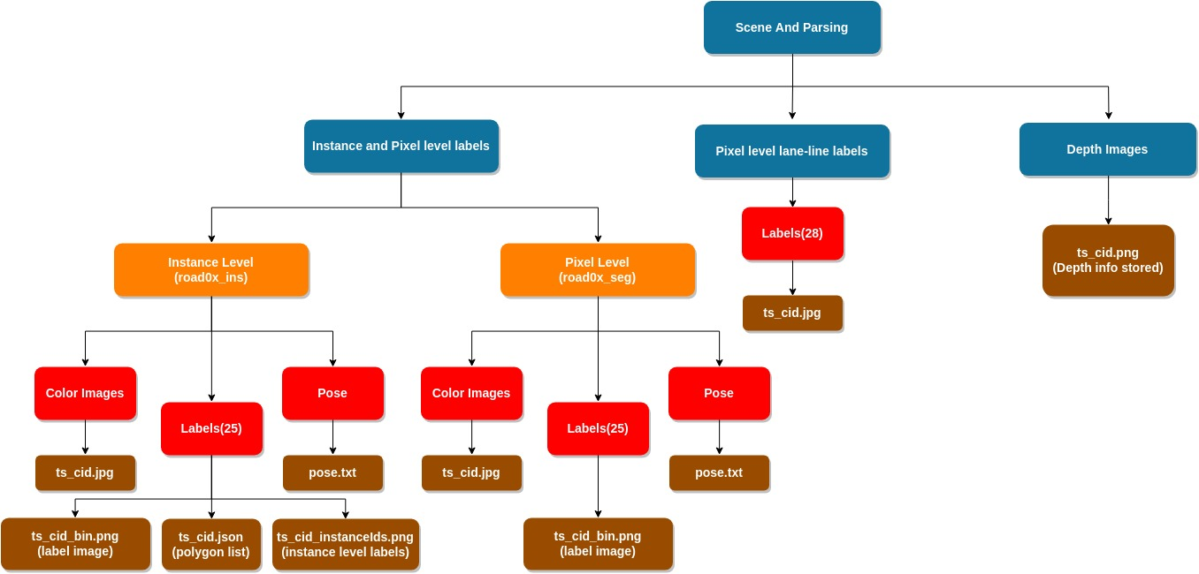
Structure of Scene Parsing Dataset

Slide 5
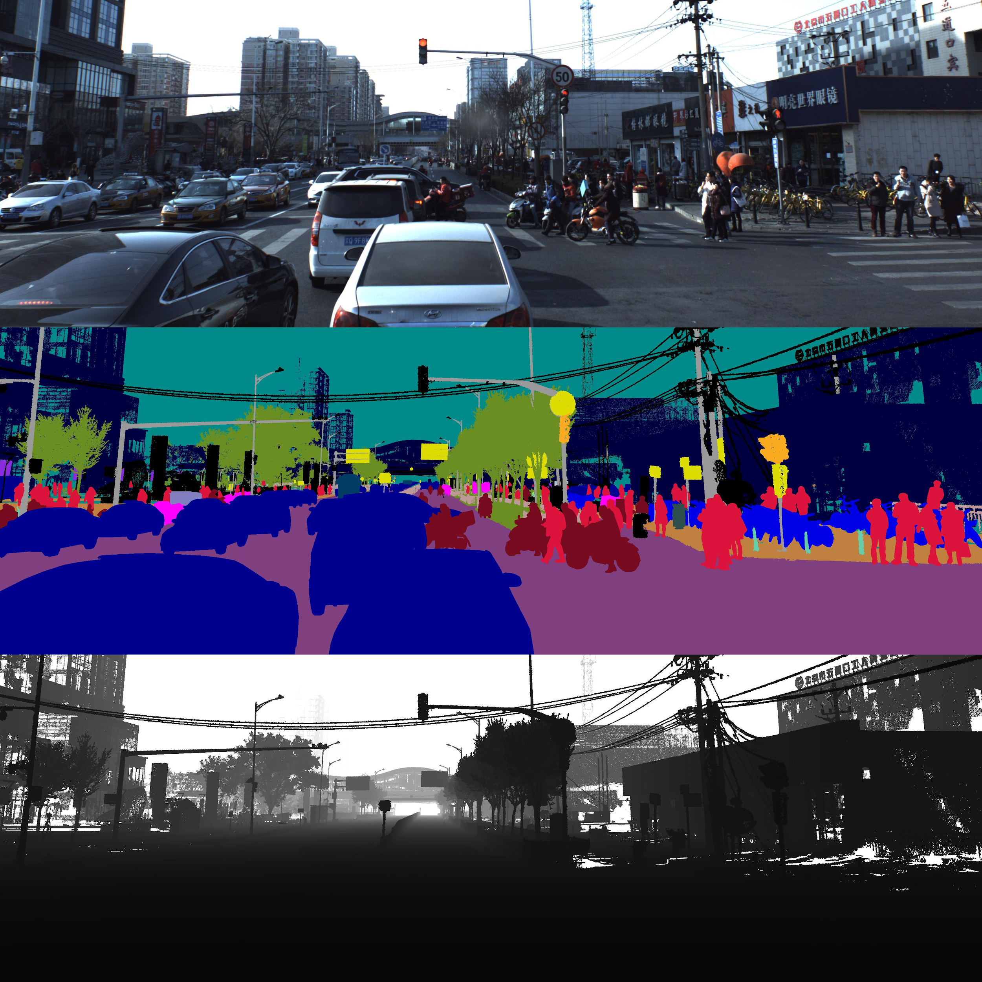
Simple Color image
Pixel Level Segmentation
Depth Image

Slide 6
sample json + sample instance level seg image

Slide 7
POSE FILE
There is only one pose file (i.e., pose.txt) for each camera and each record. This pose file contains all the extrinsic parameters for all the images of the corresponding camera and record. The format of each line in the pose file is as follows:
r00 r01 r02 t0 r10 r11 r12 t1 r20 r21 r22 t2 0 0 0 1 image_name

Slide 8
Depth Image Format
In the depth image, the depth value is save as unsigned short int format. It can be easily read in OpenCV as:
cv::Mat depth_u16 = cv::imread ( depth_path, CV_LOAD_IMAGE_ANYDEPTH);
The absolute depth value in meter can be obtained as-
double depth_value = depth_u16.at(row, col) / 200.00;

Slide 9
Labeling Process
Labeling process has 2 parts-
1. 3D labeling for static background objects.
2. 2D labeling for moving objects.
Moving objects produce a distorted poind cloud. Hence, 2D labeling. Hence, removed before 3D labeling.
3D labels are projected to 2D, combined with 2D labels to produce final pixel level segmentation.
Faulty annotations are handled manually.

Slide 10
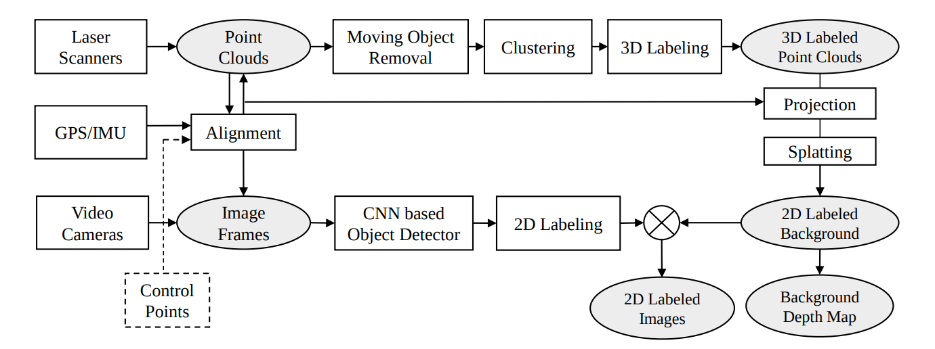
Labeling Pipeline

Slide 11
Advantages of 3D labeling
First, objects often project into several images of the video sequence, thus lowering annotation efforts considerably.
Further, the obtained 2D instance annotations are temporally coherent as they are associated with a single object in 3D.
And finally, our 3D annotations might be useful by themselves for reasoning in 3D or to enrich 2D annotations with approximate 3D geometry.

Slide 12
To speed up the process of 3D labeling, the point clouds are pre-segmented using PointNet++.
To speed up the process of 2D labeling, a CNN network is trained for movable objects to pre-segment the images.
CNN related to resnet.

Slide 13
Lane Segmentation
This gigantic dataset of total size >250GB aims to label all the lane markings on the roads.
It contains 35 labels for road markings.
Data structure is same as in Scene Parsing dataset.
The segmentation results can be directly used for HD Maps construction or updating process.

Slide 14
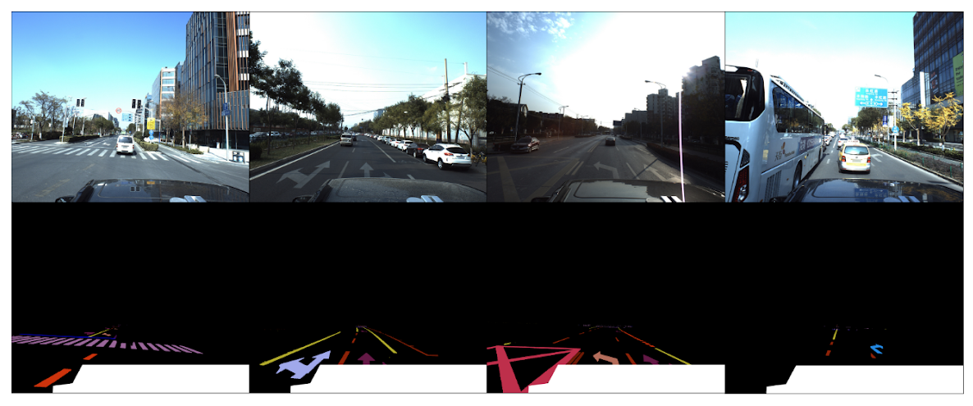
Examples of Colored Images with corresponding labels

Slide 15
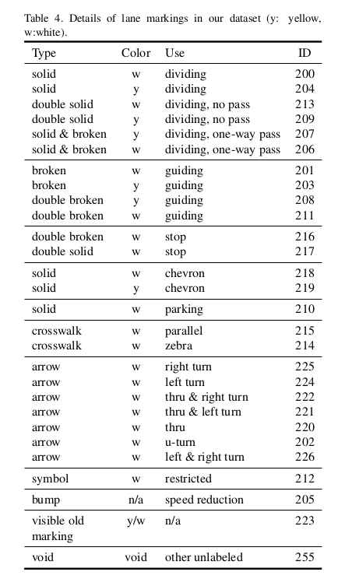
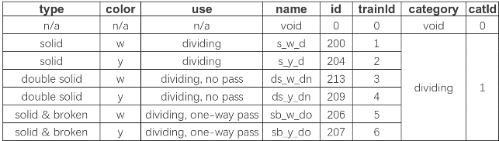
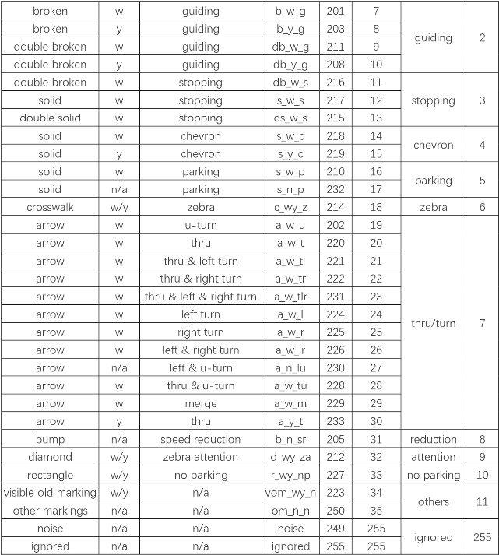
Lane Markings : Scene Parsing vs Lane Segmentation

Slide 16
Apollo Perception

Slide 17
YOLO
A new approach to object detection. Highly accurate and fast algorithm.
Actually used by apollo in perception module.
Prior work on object detection repurposes classifiers to perform detection. Instead, YOLO frames object detection as a regression problem to spatially separated bounding boxes and associated class probabilities.
About 1000X faster than R-CNN and 100X faster than fast R-CNN.

Slide 18
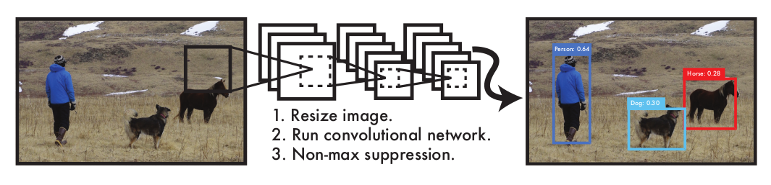
The YOLO Detection System. Processing images with YOLO is simple and straightforward. Our system (1) resizes the input image to 448 × 448, (2) runs a single convolutional network on the image, and (3) thresholds the resulting detections by the model’s confidence.

Slide 19
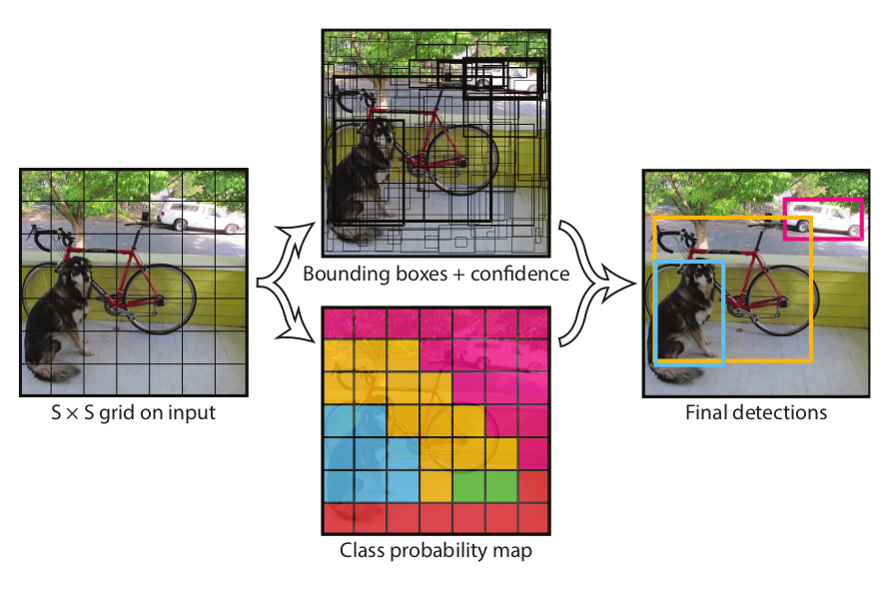
The Model- YOLO system models detection as a regression problem. It divides the image into an S × S grid and for each grid cell predicts B bounding boxes, confidence for those boxes, and C class probabilities.

Slide 20
YOLO label format
The YOLO format of labeling is as follows -
class_number box1_x1_ratio box1_y1_ratio box1_width_ratio box1_height_ratio
class_number box2_x1_ratio box2_y1_ratio box2_width_ratio box2_height_ratio
Let dW and dH be the inverse of the width and height of the image respectively.
If values xmin, xmax, ymin and ymax are known, the above values are given as-
x1_ratio = (xmin + xmax)/2 * dW
y1_ratio = (ymin + ymax)/2 * dH
width_ratio = (xmax - xmin) * dW
height_ratio = (ymax - ymin) * dH

Slide 21
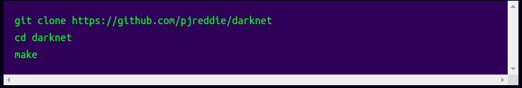
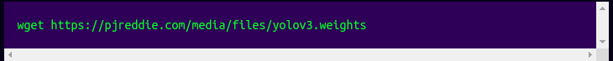
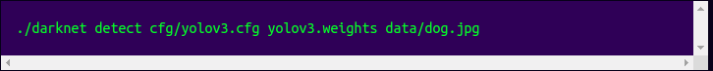
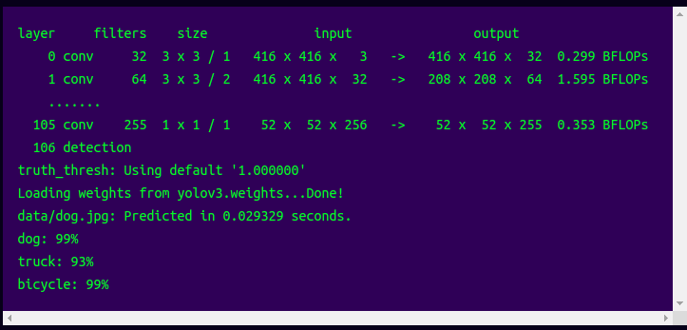
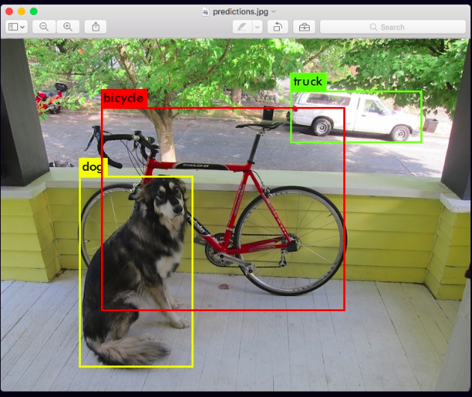
Running Pre-Trained YOLO

Slide 22
Transfer Learning

Slide 23
Custom Dataset YOLO
Few edits in the .cfg file -
Uncomment the lines 5,6, and 7 and change the training batch to 64 and subdivisions to 2.
Change the number of filters for convolutional layer "[convolution]" just before every yolo output "[yolo]" such that the number of filters= #anchors x (5 + #ofclasses)= 3x(5+1)= 18. The number 5 is the count of parameters center_x, center_y, width, height, and objectness Score. So, change the lines 127 and 171 to "filters=18".
For every yolo layer [yolo] change the number of classes to 1 as in lines 135 and 177.

Slide 24
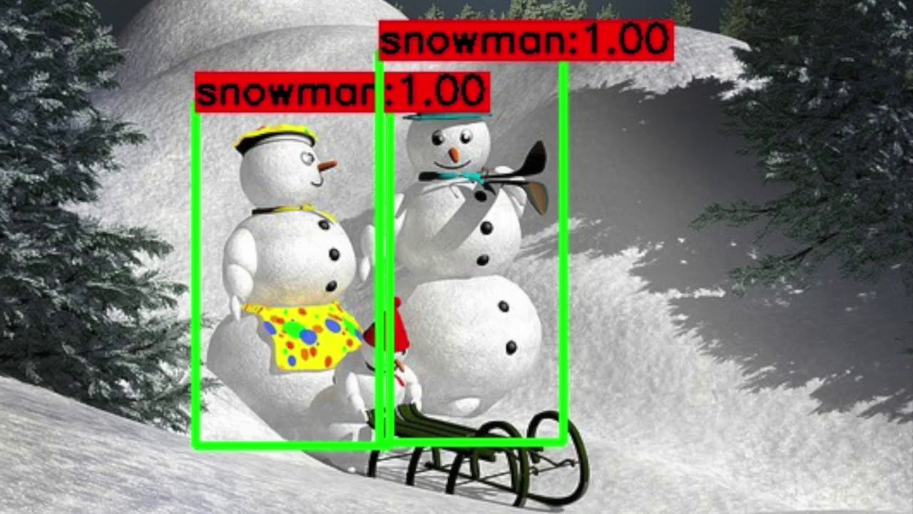
Custom YOLO - Snowman Detector

